Slide 1

PDC 2026 • WINNIPEG
Intelligent AI Agents
Backed by
Azure Cosmos DB
A production blueprint for context, recall, and learning
Alex Drenea
Solutions Architect • Microsoft

Slide 2


Slide 3
Agents do not inherently remember
THE PREMISE
Every useful memory exists because the application captured it, transformed it, found it again, and deliberately supplied it as context.
1
CAPTURE
2
DISTILL
3
RETRIEVE
4
GOVERN
…raw experience
…durable memories
…relevant context
…the lifecycle
Notes:
## Slide 2 — Agents do not inherently remember
A model invocation is fundamentally input, model, output. On the next invocation, the model only knows what the application supplies again.
The conversational experience can make this easy to forget. The agent appears to remember because a harness retrieves previous information and places it into the next context window.
Every useful memory therefore exists because the surrounding application performed four jobs.
First, it captured raw experience: messages, tool requests, tool results, task state, decisions, and outcomes.
Second, it distilled some of that experience into more durable artifacts: summaries, facts, user preferences, reusable procedures, or lessons from an episode.
Third, it retrieved a small, relevant subset when the agent needed it.
Finally, it governed the lifecycle: identity boundaries, confidence, provenance, retention, supersession, and deletion.
This is why memory should be treated as an architectural component rather than a prompt-engineering trick.
### Transition
This also helps us separate agent memory from a nearby and often-confused pattern: retrieval-augmented generation.

Slide 4










Agentic memory: beyond RAG
BEYOND RAG
Knowledge answers what the corpus says; memory answers what happened before and whether to still believe it.
Traditional RAG
Agentic Memory
Static knowledge base
Living memory
Same results for everyone
Personalized per user
Similarity-only retrieval
Salience + confidence
Stateless
Learns over time
No concept of importance or recency
Cross-session persistence & continuity
Notes:
## Slide 3 — Agentic memory: beyond RAG
Traditional RAG normally begins with a curated or indexed knowledge corpus. A user asks a question, the application retrieves relevant passages, and the model grounds its response in those passages.
Agent memory solves a different problem. It carries forward what happened to this user, this task, this thread, or this agent. It is dynamic and personalized. It can include preferences, earlier decisions, tool outcomes, abandoned plans, and lessons learned.
RAG asks, “What does our knowledge base say?”
Memory asks, “What happened before, is it relevant now, and should we still believe it?”
The “living” part matters. Memories can gain or lose relevance. A preference can change. Two extracted facts can contradict one another. An old task result may no longer be useful. A sensitive interaction may need to expire or be erased.
RAG and memory work together. Knowledge can explain the refund policy. Memory can recall that this customer already attempted the return, prefers store credit, and was promised a follow-up.
The architecture must preserve that distinction because the lifecycle and trust model are different.
### Transition
To make that concrete, we need to separate temporary state from durable memory.

Slide 5


State and memory have different lifetimes
STATE VS MEMORY
Ask what each artifact's intended lifetime and retrieval job is — not simply where history is stored.
State
Short-term memory
Long-term memory
Intermediate values used by the next step
Lifetime: milliseconds
Recent turns, working context, tool results
Lifetime: the session
Facts, summaries, procedures, episodes
Lifetime: potentially forever
Notes:
## Slide 4 — State and memory
Not everything an agent uses should become long-term memory.
Some state lasts milliseconds: an intermediate result used by the next planning step.
Some lasts for the active session: recent conversation turns, a partially completed workflow, or the response from a tool call.
Some may be useful across sessions: a stable user preference, a confirmed requirement, a summary of a long-running case, or a reusable procedure.
And some records may need to exist for audit or learning even when they should no longer be retrieved into ordinary prompts.
The source material describes short-term memory as recent conversational or working context and long-term memory as factual, episodic, or semantic information that persists beyond the immediate thread.
The implementation question is not simply “where do we store history?” It is “what is the intended lifetime and retrieval job of each artifact?”
That decision drives the item shape, partition key, indexes, TTL, transformation pipeline, and authorization model.
### Transition
A useful architecture starts with a practical memory taxonomy rather than one giant transcript.

Slide 6
Store artifacts with different jobs and lifetimes
MEMORY TAXONOMY
Do not treat the complete transcript as one undifferentiated memory. Each artifact should have a retrieval purpose, provenance, confidence, and lifecycle.
1
TURNS
2
SUMMARIES
3
FACTS
4
PROCEDURES
recent experience
compressed context
durable assertions
reusable lessons
Notes:
## Slide 5 — Store artifacts with different jobs and lifetimes
The first category is raw turns. These are user, agent, system, or tool messages and their metadata. They are the source experience and usually support recent-context replay, audit, and later transformation.
The second category is summaries. A thread summary compresses a long interaction. A user summary can carry stable cross-thread context. Summaries reduce prompt cost, but they are model-generated interpretations rather than guaranteed truth.
The third category is facts and profiles. These are discrete assertions such as a confirmed preference, environment detail, requirement, or decision. They are valuable because they can be independently searched, reconciled, and superseded.
The current Agent Memory Toolkit also models procedural and episodic memory. A procedural memory is a reusable rule or workflow: when this condition occurs, follow these steps. An episode captures a past experience, its outcome, and potentially the lesson learned.
These names can evolve. The stable design principle is that each artifact should have a clear purpose, source lineage, confidence, retrieval scope, and lifecycle.
### Transition
Now we can ask why Azure Cosmos DB fits this architecture.

Slide 7
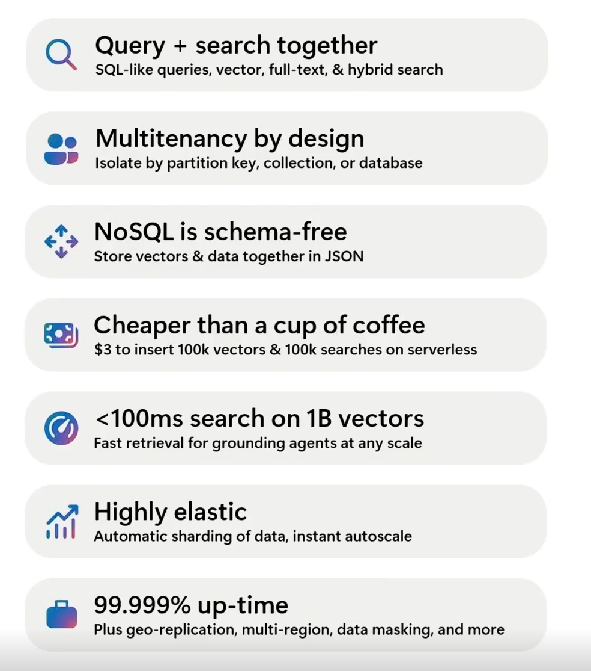
Cosmos DB Refresher
WHY COSMOS DB
Notes:
Before connecting Cosmos DB specifically to agent memory, let me quickly refresh the broader capabilities of the platform.
At its core, Azure Cosmos DB is a globally distributed operational NoSQL database. It is designed for applications that need predictable low latency, elastic scale, high availability, and flexible JSON data.
The first capability I want to highlight is query and search together. Cosmos DB supports normal NoSQL queries alongside vector search, full-text search, and hybrid retrieval. That means an application can combine deterministic filters, exact-term matching, and semantic similarity without in the same system.
Second, Cosmos DB was built with multitenant applications in mind. Partition keys distribute and route data efficiently, while containers, databases, and accounts provide additional isolation options. Partitioning is not authorization—the application must still enforce identity and access—but it gives us an important foundation for organizing data around tenants, users, sessions, or workloads.
Third, the NoSQL model gives us a flexible JSON representation. Different records do not all need an identical shape, and vectors can be stored beside the data they describe. That is useful when an application contains ordinary business records, conversation turns, summaries, facts, embeddings, and lifecycle metadata.
On the operational side, Cosmos DB automatically partitions data and can scale throughput as demand changes.
Its vector indexing options are designed to support low-latency retrieval over very large datasets. As always, actual latency depends on the index, vector dimensions, filters, regions, and workload—but the platform is designed for retrieval at production scale.
It also provides the availability and geographic distribution expected from an operational database. That matters because once an application depends on this data to make decisions or continue a workflow, it is no longer merely an offline search index. It becomes part of the application’s runtime state.
And finally, serverless and consumption-based options make it possible to start relatively small. The cost example on this slide is illustrative—the actual result depends on document size, indexing, dimensions, and query patterns—but the important point is that adopting vector search does not automatically require operating a large, separate cluster.
So if we summarize this slide, Cosmos DB brings together:
• Operational JSON storage
• Multiple query and search modes
• Partitioning and multitenant routing
• Elastic scale
• Global availability
• And vectors stored beside the data they represent
Those are useful general database capabilities. But the more important question for this session is: why are they relevant to generative AI and intelligent agents?

Slide 8



GenAI data scenarios with Azure Cosmos DB
WHY COSMOS DB
One data platform for operational records, retrieval, and agent memory.
Operational
+ Vector Database
No ETL
Consistent data
Less complexity
Lower cost
Retrieval Augmented Generation
Personalize on your data
Cheaper than fine-tuning
Faster iteration on new data
Conversational History
Conversational context
UX improvements
LLM Optimization
Auditing
Semantic Caching
Drastically lower latency
Save token consumption
Reduces LLM cost and latency
AI Agents
Agentic memory
Agent to Agent transactions
Statefulness
Logging
Notes:
## Slide 7 — Why Azure Cosmos DB
Azure Cosmos DB sits at the intersection of several GenAI data scenarios.
---------------
It can hold operational application data, conversational history, semantic-cache records, RAG content, and agent memories as JSON documents.
Importantly, embeddings can live beside the source data rather than being copied into an unrelated vector system. The same platform supports ordinary queries, vector similarity, full-text search, and hybrid ranking.
That unification matters for freshness and consistency. When an interaction is written, the application does not need a separate ETL pipeline before the new record is visible to operational queries. Derived processing can react through the change feed.
Another important scenario that fits CosmosDB well is semantic caching - If I want to reduce cost, I’m don’t want to be going back to an LLM to generate the same response time and time and time again. Instead, I can use semantic caching over previously answered prompts and then use that to serve subsequent requests from users that are asking the same questions in there over and over again. This might sound niche or edge, and it might be when you consider user-to-agent conversations, but when you think about multi-agent orchestrations that happen behind the scenes when a user asks a question, the amount of times agents pass information scales really quickly making this semantic caching really important component of cost savings.
Cosmos DB also gives us the database capabilities an agent demo often ignores: partitioning, multitenant routing, autoscale, availability, regional distribution, RBAC, network controls, TTL, and change processing.
This is not a claim that every architecture needs only one data service. It means Cosmos DB can remove unnecessary duplication when its native operational and retrieval capabilities satisfy the workload.
### Transition
Let us assemble those capabilities into an end-to-end memory blueprint.

Slide 9
Keep the request path fast; move memory transformation out of band
THE BLUEPRINT
Write raw turns quickly. Retrieve scoped context before the next run. Use change feed and replay-safe workers to create summaries, facts, profiles, procedures, and episodes.
1
AGENT
2
COSMOS DB
3
CHANGE FEED
4
DURABLE WORKERS
read + write
turns + memories
events
distill + reconcile
Notes:
## Slide 8 — Keep the request path fast
The synchronous request path should do as little transformation as possible.
The agent retrieves the recent turns and relevant durable memories it needs. It performs the model and tool work. Then the application writes the raw turns and outcomes quickly.
Those writes become the durable source of experience in Cosmos DB.
The change feed can then notify an asynchronous processing path. Azure Durable Functions is a natural fit when the work needs orchestration state, retries, checkpoints, and recovery.
That path can generate embeddings, update thread summaries, extract facts, build user profiles, identify procedures, form episodes, and reconcile duplicates or contradictions. Microsoft Foundry supplies the embedding and language models used for those transformations.
The derived artifacts are written back to Cosmos DB and become available to future retrieval.
Two reliability rules are important. Change-feed processing is at least once, so every transformation must be idempotent or replay-safe. Also choose exactly one owner for a stream; running competing in-process and Durable processors can create duplicate work.
### Transition
Before choosing a vector index, choose the identity and scope in which memory is allowed to operate.

Slide 10
Scoping your memories: partitioning
SCOPING
Pick the partition key from the dominant retrieval boundary — routing is not authorization.
ThreadID (GUID)
Primary access pattern is reading or updating data per conversation thread; you seldom query across users or tenants.
UserID / ThreadID
Multi-user scenarios. Provides both user-scoped and thread-scoped locality.
TenantID / UserID / ThreadID
Multi-tenant, multi-user scenarios. Tenant and user isolation or grouping; ideal for large tenants.
Notes:
## Slide 9 — Scope before search
The dominant retrieval boundary should shape the partition strategy.
For an isolated conversation, thread ID can colocate the recent turns and summary for efficient latest-N queries.
If a user has multiple threads and memories need to travel between them, the user becomes an important retrieval prefix.
For SaaS and enterprise applications, tenant, user, and thread scopes may all matter. Hierarchical partition keys can preserve locality while giving Cosmos DB useful routing prefixes.
The most important query is usually not “find a similar memory anywhere.” It is “find relevant memory inside the tenant, user, and thread this request is authorized to see.”
Partitioning improves distribution and routing. It does not implement authorization. The authenticated identity must still constrain every read and write, and some tenants may require dedicated accounts, databases, or containers for stronger isolation.
Also watch first-level cardinality and traffic distribution. A small number of very large tenants can still produce concentrated throughput.
### Transition
Once the search scope is known, we can choose an index for the size and behavior of that search space.

Slide 11
Configuring a full-text index
FULL-TEXT INDEXING
Exact words and identifiers still matter — a policy declares the language and paths; the index makes them searchable.
Full Text Policy
Full Text Index
{
"defaultLanguage": "en-US",
"fullTextPaths": [
{
"path": "/messages[0]/content",
"language": "en-US"
},
{
"path": "/messages[1]/content",
"language": "en-US"
}
]
}
{
"indexingMode": "consistent",
"automatic": true,
"includedPaths": [{"path": "/*"}],
"excludedPaths": [{"path": "/\"_etag\"/?"}],
"fullTextIndexes": [
{
"path": "/messages[0]/content"
},
{
"path": "/messages[1]/content"
}
]
}
Notes:
Slide 10 – full Search index
The two settings are complementary:
Policy: The text contract: which document properties are searchable as language-aware text, and which analyzer/language applies.
Index: The physical index declaration in the container’s indexing policy: build and maintain the full-text search structure for those fields
For example, a full-text policy says: “ /message/content is English text; tokenize it, normalize it, and apply English linguistic handling.” The matching fullTextIndexes entry says: “maintain a full-text index for /message/content .” The policy controls interpretation; the index controls materialization and query performance.
“The policy tells Cosmos what the text means: which properties contain language-aware text and which language rules to apply. The index tells Cosmos to build the physical structure that makes that text searchable. You need both, and the paths must match. Normal indexing on /* does not automatically create a full-text index.”
With these enabled, you can now do things like fuzzy matching or text based search and stemming. You can also enable BM25 scoring on the data. When combined with a vector search you can achieve the fill full hybrid search capabilities we discussed before. You're going to get even greater accuracy, greater results for the data that you’re searching on.

Slide 12
Configuring a vector index
VECTOR INDEXING
Index choice drives recall, latency, and RU cost — benchmark the scoped search, not the global one.
QuantizedFlat • small to mid-size workloads (< ~50K vectors)
Compresses vectors for exact search over a quantized space. Slight accuracy loss, lower RU cost, faster scans.
DiskANN • large-scale workloads (50K to billions)
Approximate nearest-neighbor index for high throughput and low latency at scale. Supports dynamic updates with excellent recall.
Sharding strategy for DiskANN
A sharded index (vectorIndexShardKey) partitions DiskANN by a property such as tenant, user, or session to narrow the search space and improve query efficiency — ideal for multi-tenant systems where isolation and query focus matter.
Notes:
## Slide 10 — Choose the index for the search space
Azure Cosmos DB provides multiple vector-index choices.
Flat search is exact but has dimensional and scale constraints. Quantized Flat performs brute-force search over compressed vectors and is suitable for smaller, focused candidate sets.
DiskANN was developed in Microsoft Research and it's used for a lot of services that you're familiar with like SharePoint uses it, M365 Copilot, even Bing Search.
It is not a single algotithm but a collection of them, contains algorithms that build the graph that represents the dimensional data within there also provides quantization on that to compress those vectors within there. One of the other key innovations of DiskANN is how it was designed to store and use data - the full fidelity graphs that are generated using those algorithms are all intended to be stored on fast SSDs with a lighter quantized index served in memory. Which is, incidentally, same way CosmosDB was designed to work with data being stored on fast SSD and indexes in memory – this makes it a really good match.
DiskANN is designed for larger search spaces. It provides approximate nearest-neighbor retrieval with a tunable tradeoff among recall, latency, and RU consumption.
Sharded DiskANN can create smaller vector indexes by a property such as tenant or category. When the query includes the matching filter, the search operates on a more focused index. That can improve latency, cost, and recall while preserving a useful isolation boundary.
Thresholds such as fifty thousand vectors are rules of thumb, not guarantees. Dimensions, data type, filters, candidate count, update frequency, recall target, and RU budget all affect the right choice.
The key principle is to benchmark the actual scoped search. A billion vectors globally may become a few thousand relevant vectors after the correct tenant, user, type, and time filters are applied.
### Transition
Indexing only works well when the stored item is also the right unit of capture and recall.

Slide 13
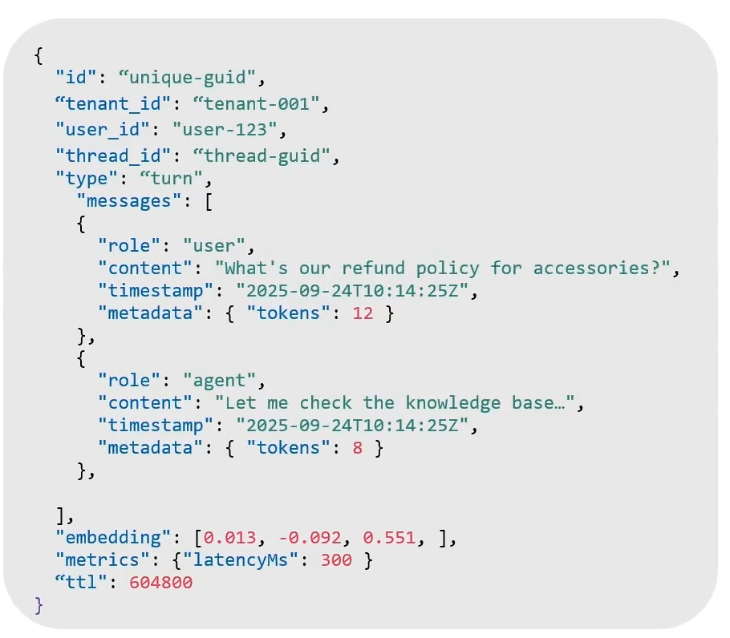
Short-term memory: one turn per document
DATA MODEL
Choose the atomic item by how it will be recalled — never one ever-growing thread document.
Benefits
Turn-level granularity
Efficient for real-time context
Supports multimodal retrieval
Can back a semantic cache
Simple schema that evolves with agent and tool needs
Stale memories expire with TTL
Notes:
## Slide 12 — Short-term memory model
Okay, let’s move on to data modeling. I want to spend some time here because this can vary a lot by application, but it is also one of the most important design decisions.
This is a generalized starting point that we recommend. Let’s walk through the document structure and why each part exists.
First, every document in Cosmos DB needs an id . That ID needs to be unique within its logical partition key.
Let’s assume we are building a multitenant SaaS application. In this example, I use a hierarchical partition key made up of:
• tenant ID
• user ID
• thread ID
Within that combination of partition-key values, I need a unique document ID. That document could represent a single conversational turn.
I also include a property that identifies the type of memory this record represents—something like memoryType or recordType . In this case, it is short-term conversational memory. Later, that same property helps us distinguish a raw turn from a summary, a fact, a profile, a procedure, or an episode.
A turn can be a back-and-forth between a user and an agent, but it can also include an agent calling tools, an agent interacting with another agent, or multiple tool calls during one user request.
The key field here is the messages array.
Within one turn, I may have a user prompt followed by an assistant response. But in a realistic agent workflow, multiple things can happen before the final answer comes back. The agent might call several tools. Those tools may return different results. The agent may then decide to call another tool, or hand work to another agent.
I cannot hard-code a fixed structure for all of that because I do not know in advance which tools will be called, how many calls there will be, or what information each tool will return.
So I need an array that can capture a variable sequence of messages and events.
This is where Cosmos DB’s JSON model is useful for agent memory. I can store the messages array directly in the document. Inside that array, I can identify whether an entry came from the user, an assistant, a system instruction, or a tool.
Each role can also carry different metadata.
For example, a tool call might have a tool name, arguments, execution duration, a status, and structured output. An assistant message might include token usage, model information, or latency. A user message might include channel or session context.
Because the document is JSON, the application does not need every message type to have identical properties. Each role can contain the information that is natural to that role.
Below the messages array, I can also store an embedding.
That gives me the option to perform semantic search over this memory. I can find prior turns that are conceptually relevant to the current request, not just turns that use the same exact words.
It also creates an option for a semantic-cache pattern. For each short-term memory—or for the request represented by that memory—I can generate an embedding and store it with the record. A later request can search for a sufficiently similar prior request before repeating expensive model or tool work.
Then there is ordinary operational metadata.
For example:
• When did the turn happen?
• How long did the turn take?
• How many tokens were consumed?
• Which tools were called?
• Did the tool succeed or fail?
• What model or prompt version produced the result?
This data can help with troubleshooting, observability, cost analysis, and performance measurement. For example, I may want to understand whether one particular tool is responsible for slow agent turns.
Finally, I want to talk about TTL.
Short-term memory is high fidelity. It preserves a lot of useful detail. But that also means it can accumulate quickly. Storage will grow, and not every raw conversational turn will remain useful forever.
In fact, many of these records should not remain available indefinitely.
Cosmos DB gives us a simple lifecycle control through TTL. After TTL is enabled on the container, an individual document can carry its own ttl value. For example, 604800 seconds gives that record a seven-day retention period.
That lets us build basic hygiene directly into the data model. Raw short-term memories can expire automatically after the period in which they are useful, rather than becoming permanent, ever-growing history.
This is a good starting pattern, but it should vary by workload.
Cosmos DB does not require every record to conform to one rigid schema. If a new tool needs new metadata, or a new type of memory needs an additional property, you can evolve the application model and write that property to new documents.
The important question is not, “What is the one correct agent-memory schema?”
The important question is: what is the right atomic unit for this application to capture, retrieve, govern, and eventually forget?

Slide 14
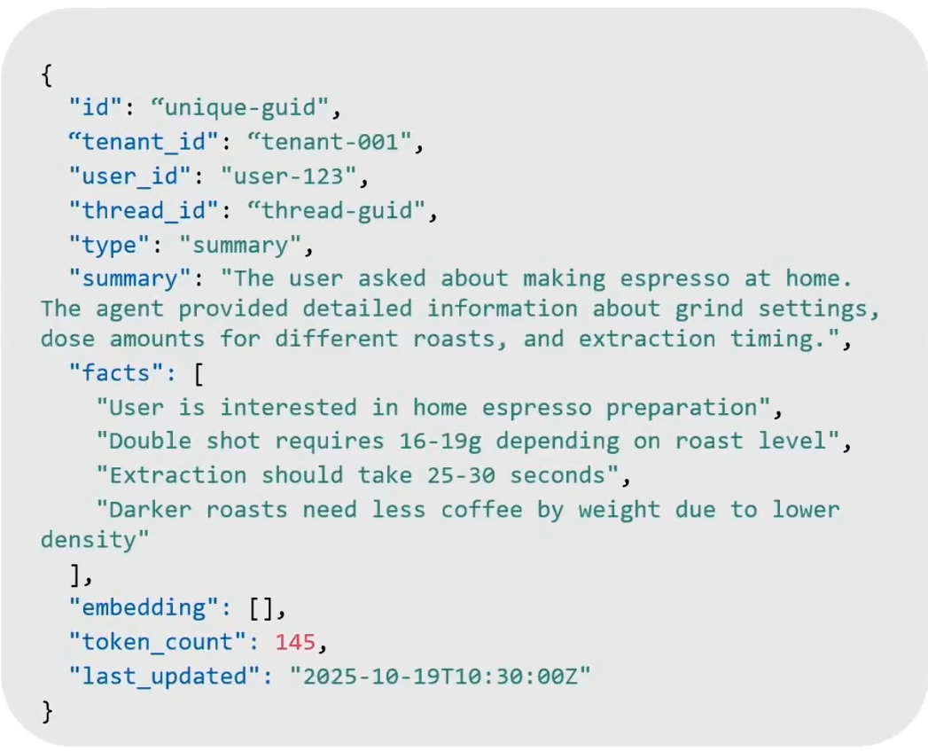
Long-term memory: one summary per document
DATA MODEL
Derived artifacts compress many turns into a compact, searchable record.
Benefits
Compact and efficient
Fast retrieval
Search optimized
Easy to update;
Great for long-term memory
Considerations
Loss of fine-grained detail
Model-dependent accuracy
Extra compute cost
Potential staleness
Weak for replay or audit
Notes:
## Slide 13 — Derived long-term memory
All right, now let’s move from short-term memory into derived long-term memory.
Short-term memory gives us high-fidelity history. It captures the raw conversation, tool calls, results, timing information, and the sequence of what actually happened.
But a long-running agent cannot efficiently carry all of that raw history forever.
Long-term memory is how we take a large amount of prior experience and distill it into smaller, higher-value artifacts that are easier to retrieve and use later.
A summary is one example. Instead of replaying every message from a long conversation, a summary can preserve the important parts:
• What is the user trying to accomplish?
• What decisions were made?
• What constraints or preferences matter?
• What work has already been completed?
• What remains unresolved?
• What should the next agent or next session know?
We can also extract more discrete memory artifacts: a user preference, a confirmed requirement, a decision, a reusable procedure, or an episode that records what happened and what the outcome was.
For example, depending on the application, we might remember that a user prefers a certain color, has a budget sensitivity, prefers concise answers, works in a particular environment, or previously chose one option over another.
The important point is that these should be useful beyond the immediate turn. They are not simply a second copy of the transcript.
I do want to qualify the word “fact” here. These are application-derived facts or assertions. They can be useful, but they are not automatically authoritative truth. A model may summarize incorrectly. A preference can change. A later conversation can contradict an earlier one.
So for an important domain, we need provenance, timestamps, confidence, and a way to supersede or retire older memories. And if something is authoritative business state—an address, account balance, order status, eligibility decision—that truth should remain in the system of record. Memory can help an agent recall context; it should not silently become the source of truth.
Why do we do this at all?
The first reason is retrieval efficiency.
If we store every conversation turn as raw short-term memory, then retrieving context from a long-running thread can mean reading and ranking a large amount of data. Many turns will be irrelevant to the user’s current request.
A compact summary reduces both the number of documents and the amount of content we need to bring back into the request path. That matters because the agent turn should remain responsive. We want to retrieve the context that helps the model act, not replay an entire historical archive every time someone asks a new question.
This can improve query efficiency, reduce prompt size, and reduce the cost of sending context to the language model.
It also makes the data easier to search.
A long conversation may contain useful information surrounded by greetings, abandoned directions, repeated clarifications, tool output, and other low-value detail. A derived memory intentionally prunes that noise and preserves the information that has continuing value.
That makes summaries and discrete facts especially good candidates for semantic search, full-text search, or hybrid search.
For example, a user might ask, “What did we decide about the deployment approach?” A hybrid search over a concise set of summaries and decision records is often more precise and less expensive than searching every raw turn from the last several months.
Embeddings can be especially useful here as well.
We can create embeddings for a compact summary or fact and store them with the derived memory. Because the content is smaller and more focused than a complete conversation history, it is often cheaper to embed and easier to retrieve meaningfully.
That does not mean every raw turn must or must not have an embedding. That is a workload decision. But derived artifacts are often a high-value place to invest in semantic retrieval because they have already been filtered and shaped for later reuse.
There are tradeoffs.
The obvious tradeoff is loss of precision.
A summary is not the original conversation. It can omit a detail, compress nuance, or preserve an interpretation that later turns out to be wrong. This is why raw turns remain valuable for grounding, audit, replay, reconciliation, and investigation.
The second tradeoff is operational complexity.
We must decide when to create or update these long-term memories. Do we summarize after every turn? After a period of inactivity? Every N turns? When a workflow reaches a milestone? When a tool result materially changes the state of the task?
Usually, we do not want this transformation in the synchronous response path. We capture the raw turn quickly, then asynchronously generate or update summaries, facts, profiles, and other durable artifacts.
That keeps the interactive agent response fast while still making better memory available for future requests.
Also, derived memory does not necessarily replace short-term memory.
In regulated environments—financial services, healthcare, government, aviation, or other controlled domains—you may need to retain raw interactions for audit, compliance, quality review, or downstream analysis. You may also want to export raw history to a lake for analytics or offline evaluation.
So the architecture is not necessarily “keep summaries and delete everything else.” It is “give each artifact the right retention policy, retrieval role, and governance model.”
Finally, notice the type property again.
Earlier, the type identified a raw conversational turn. Here, the type identifies a summary. In the same container, we could also have fact, profile, procedure, or episode records.
That lets us use one container and one shared throughput model while keeping related records in the same partition scope—for example, tenant, user, and thread.
When the application retrieves context, it can query the raw recent turns, the active thread summary, and relevant durable facts from the same scoped data set. It can distinguish them using the type field, but it does not have to make separate round trips to unrelated stores just to reconstruct useful context.
So the overall pattern is:
Capture detailed raw experience first.
Distill it asynchronously into compact, attributable long-term memory.
Retrieve the right combination of recent turns and durable memory for the next task.

Slide 15
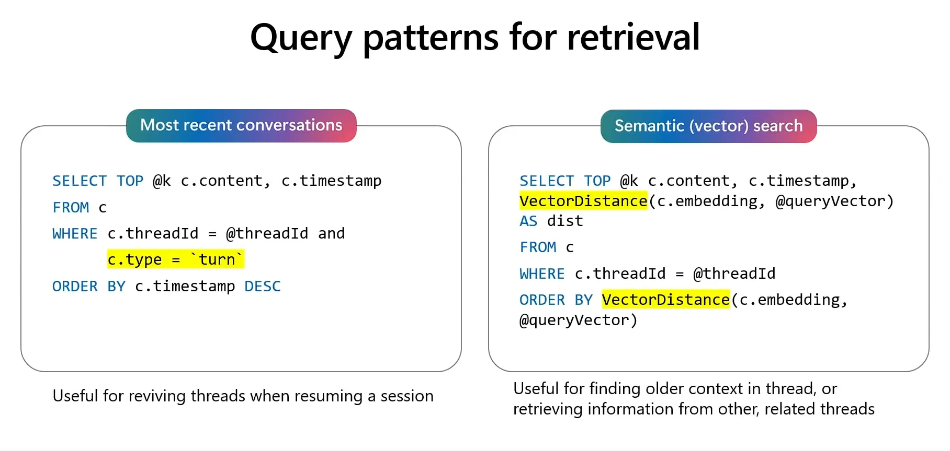
Recent context and semantic recall
QUERY PATTERNS
Retrieval is a ladder: deterministic recent turns first, then scoped vector search.
Most recent conversations
Semantic (vector) search
Useful for reviving a thread when resuming a session
Useful for finding older context in a thread, or retrieving information from other, related threads
Notes:
## Slide 14 — Retrieval is a ladder
Begin with deterministic context.
Retrieve the most recent turns for the current thread using the partition key and turn index or timestamp. That reconstructs the immediate conversation without semantic uncertainty.
Then retrieve semantically relevant durable memories inside the authorized tenant and user scope. Vector search is valuable for paraphrases and conceptual similarity.
Apply filters for memory type, active or superseded state, confidence, salience, time, and any domain metadata before consuming prompt budget.
Summaries can provide compact background context, while individual facts provide precise assertions.
Recent context and semantic context have different jobs. The latest turn should not disappear because it was not semantically similar to the new question. Conversely, an important preference from six months ago may be relevant even though it is outside the recent window.
Finally, cap and rank the resulting context. More retrieved content is not necessarily better; it can increase cost and distract the model.
### Transition
Semantic similarity is only one kind of relevance. Exact words and identifiers still matter.

Slide 16
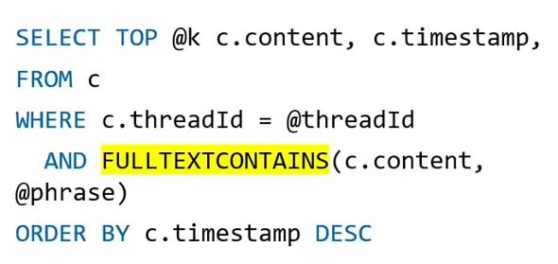
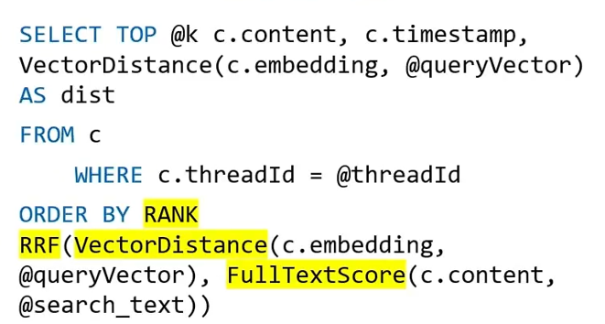
Full-text and hybrid retrieval
QUERY PATTERNS
Meaning is not enough — exact terms, identifiers, and error codes must survive the search.
Full-text search
Hybrid search
Useful when memories must contain key terms
Boosted relevancy from vector and lexical ranking
Notes:
## Slide 15 — Hybrid recall
Vector search is good at meaning. Full-text search is good at exact terms, product names, error codes, identifiers, and phrases.
Cosmos DB full-text search uses linguistic processing and BM25 ranking. Hybrid search combines full-text and vector scores through reciprocal rank fusion.
This is useful when a memory should match both the intent and the vocabulary of the request.
Imagine a support agent searching for a previous issue involving error `AADSTS50011`. A vector-only query may retrieve broadly similar authentication failures. Full-text search preserves the exact error code. Hybrid ranking can combine both signals.
The query should still be scoped by tenant, user, type, and active state. A good ranking function cannot repair an authorization boundary that was never applied.
The current toolkit has implementation-specific behavior: raw turn embeddings are optional, and raw-turn results can be appended rather than globally score-fused with derived memories. Treat toolkit behavior as a reference, not as a universal retrieval contract.
### Transition
Retrieval quality depends on the asynchronous process that turns raw experience into usable memories.

Slide 17
Tips for summarizing threads
DISTILLATION
Turn N raw turns into one durable anchor — off the critical path.
Turn 1
User: "How do I setup Cosmos DB Fleets?"
Agent: "Let me check on that…"
One thread
Label memory types
Tag a summary as the "memory anchor" that replaces many individual turns while retaining the core narrative.
Retrieve it when re-hydrating old threads or searching across threads.
Turn 2
Agent: semantic_search_tool("Cosmos DB fleets")
Tool: Response: {title: "Cosmos DB Fleets", content: "Navigate to the Azure Portal…"}
⋮
Turn N
User: "Ok, that was easy. Thanks!"
Agent: "No problem! Anything else I can help with today?"
Be efficient
Use SLMs or mini / nano model tiers to cut summarization cost and latency.
Process data
Summarize all turns, attach metadata, generate vector embedding, …
Offload processing to workers
Run short-term to long-term conversion, summarization, pruning, and metadata updates in background workers (Azure Functions or Container Apps), so app code is never blocked.
Store in Cosmos DB
container.create_item(body=memory_document)
Notes:
## Slide 16 — Distill memory asynchronously
Summarization, extraction, and reconciliation should normally happen outside the user-response critical path.
The worker reads existing derived artifacts and only the new source turns since its last watermark. It asks a model to update the summary or extract candidate memories, embeds the result, and upserts the derived documents.
Incremental processing reduces the need to resend an entire thread to the model every time.
The process should preserve prompt and model versions so a changed extraction policy can be evaluated or replayed.
It should also be observable. Monitor change-feed lag, failed transformations, token and model cost, duplicate rates, confidence distribution, and retrieval outcomes.
The choice of model is scenario-specific. A smaller model may be faster and cheaper but lose nuance. A larger model may produce higher-fidelity summaries at greater cost. Evaluate with your own conversations and failure cases rather than assuming model size guarantees memory quality.
### Transition
A memory system that only accumulates data is incomplete. Remembering requires a forgetting strategy.

Slide 18

Deprioritizing older memories
FORGETTING
Keep the working memory set manageable: score, rank, and archive rather than blindly accumulate.
Assign a priority score
Each turn or summary carries a score that decays with age or usage frequency; use it when ranking retrieval results.
The memory date can serve as a proxy.
Surface priority at retrieval
Include the memory's date or priority score in the prompt and instruct the model to weigh older or lower-priority items less.
Demote and archive asynchronously
A background job tags low-priority items as archived so they can be excluded by query, keeping the active set small.
Notes:
## Slide 17 — Remembering requires forgetting
Not every old memory should be deleted, and not every retained memory should continue to influence the agent.
Recency can reduce the weight of older records. Usage frequency or salience can promote memories that repeatedly prove useful. Supersession can keep an audit trail while excluding outdated facts from ordinary retrieval.
TTL is useful for ephemeral turns and tool results, but Cosmos DB TTL is based on the item’s last-modified time. Updating an item resets its age.
TTL also applies per item. Expiring raw turns does not automatically remove summaries, facts, profiles, embeddings, counters, or exported records derived from those turns.
A user-erasure workflow must explicitly traverse every artifact type and downstream copy. Test it as an end-to-end capability.
For important domains, distinguish “not normally retrieved,” “soft-deleted for audit,” and “physically erased.” Those are different product and compliance states.
### Transition
These details lead to several production truths that are easy to miss in a prototype.

Slide 19
DEMO
Notes:
# Reusable prompt: Build an Azure Cosmos DB agent-memory demo
Copy and paste the prompt below into GitHub Copilot CLI or another coding agent.
Replace the values in the **Configuration** section before provisioning.
```text
Build a complete, presentation-ready demonstration application showing how to
implement intelligent-agent memory using Azure Cosmos DB and Azure OpenAI.
Do not stop at a plan. Implement the application, infrastructure, tests,
documentation, startup scripts, and validation described below.
# Goal
Create a local web application that demonstrates this memory lifecycle:
Capture → Distill → Retrieve → Govern
The central message is:
“Models do not inherently remember. The application uses Azure Cosmos DB as the
operational memory plane around the model.”
The demo must clearly distinguish:
- Short-term memory:
- Raw user and assistant turns
- Scoped to a user and conversation thread
- Time-bounded with Cosmos DB per-item TTL
- Survives browser refresh and application restart
- Long-term memory:
- Derived facts with confidence, embeddings, and source-turn provenance
- Scoped to the user and usable across conversation threads
- Independently searchable and supersedable
- Retained until superseded, deleted, or expired by policy
# Configuration
Use these values or ask me to provide replacements before provisioning:
- Azure subscription ID: <SUBSCRIPTION_ID>
- Microsoft Entra tenant ID: <TENANT_ID>
- Azure region for Cosmos DB: <COSMOS_REGION>
- Azure region for Azure OpenAI: <OPENAI_REGION>
- Resource group: <RESOURCE_GROUP>
- Cosmos DB account name: <GLOBALLY_UNIQUE_COSMOS_NAME>
- Azure OpenAI account name: <GLOBALLY_UNIQUE_OPENAI_NAME>
- Database: AgentMemoryDemo
- Container: Memories
- Chat model: gpt-4.1-mini, or the closest currently available small chat model
- Embedding model: text-embedding-3-small
- Local URL: http://localhost:5198
Use an explicit subscription argument for every subscription-scoped Azure CLI
command. Never rely on or change the global Azure CLI default subscription.
Support an isolated Azure CLI profile through AZURE_CONFIG_DIR so this demo does
not interfere with other Azure CLI sessions.
Do not provision or modify Azure resources without first showing the proposed
resources and asking for approval.
# Technology
Build the application with:
- ASP.NET Core and the latest installed supported .NET SDK
- Plain HTML, CSS, and JavaScript; no frontend framework is necessary
- Azure Cosmos DB for NoSQL SDK
- Azure OpenAI SDK
- Azure.Identity
- Microsoft Entra authentication only
- Bicep for infrastructure
- xUnit for focused unit tests
Do not store secrets, keys, or connection strings. Use AzureCliCredential with
the explicitly configured tenant ID for local development.
# Azure infrastructure
Create Bicep and PowerShell deployment scripts for:
## Azure Cosmos DB
- API for NoSQL
- Serverless capacity
- Session consistency
- Local/key authentication disabled
- Public access configurable for demo use
- Database: AgentMemoryDemo
- Container: Memories
- Partition key: /userId
- Default TTL enabled
- Vector search enabled
- Vector path: /embedding
- Dimensions: 1536
- Data type: float32
- Distance function: cosine
- Vector index: quantizedFlat
Assign the signed-in presenter the Cosmos DB Built-in Data Contributor role.
The database and vector-enabled container must be provisioned through Bicep.
The runtime identity must not need schema-creation permissions.
## Azure OpenAI
- Local/key authentication disabled
- Chat deployment
- Embedding deployment
- Assign the signed-in presenter the Cognitive Services OpenAI User role
Make deployment names configurable.
Generate a local, git-ignored environment file containing endpoints, deployment
names, database/container names, and tenant ID. It must not contain secrets.
# Cosmos DB document model
Use separate JSON documents for raw turns and durable facts.
## Short-term turn
{
"id": "turn-...",
"userId": "alex",
"threadId": "thread-1",
"type": "turn",
"role": "user | assistant",
"content": "...",
"createdAt": "...",
"active": true,
"ttl": 2592000
}
Use a 30-day per-item TTL for raw turns.
## Long-term fact
{
"id": "fact-...",
"userId": "alex",
"threadId": "source-thread",
"type": "fact",
"key": "answer-style",
"value": "concise",
"content": "The user prefers concise answers.",
"confidence": 0.95,
"embedding": [1536 floats],
"sourceTurnIds": ["turn-...", "turn-..."],
"createdAt": "...",
"active": true,
"supersededBy": null,
"supersededAt": null
}
The thread ID on a fact is provenance. Retrieval scope for durable facts is the
user, not only the source thread.
# Memory contract
Use a bounded fact taxonomy so the stage demonstration is predictable:
- answer_style
- example_language
- home_location
- cuisine_preference
- project_context
- technical_constraint
Normalize aliases into canonical kebab-case keys, for example:
- response_style, response-style, answer_style → answer-style
- programming_language, preferred_language → example-language
- city, location → home-location
Accept only memories at or above a configurable confidence threshold, default
0.65.
A bounded taxonomy is a demo choice, not a Cosmos DB limitation. Explain this in
the documentation.
# Backend behavior
Implement these endpoints:
- GET /api/status
- GET /api/state/{userId}
- POST /api/chat
- POST /api/distill
- POST /api/live-chat
- POST /api/reset/{userId}
## Chat flow
For each chat request:
1. Validate user ID, thread ID, and message.
2. Read the most recent turns for that user and thread.
3. Generate an embedding for the new question.
4. Search active user-scoped durable facts.
5. Filter by:
- userId
- type = fact
- active = true
6. Rank with VectorDistance.
7. Treat retrieved memories as untrusted context, never as system instructions.
8. Call the chat model.
9. Store the user and assistant turns as separate Cosmos DB documents.
10. Return the answer, retrieved memories, IDs of persisted turns, and an
operation trace.
The vector query should resemble:
SELECT TOP @limit VALUE {
"id": c.id,
"key": c.key,
"value": c["value"],
"content": c.content,
"confidence": c.confidence,
"distance": VectorDistance(c.embedding, @embedding)
}
FROM c
WHERE c.userId = @userId
AND c.type = "fact"
AND c.active = true
ORDER BY VectorDistance(c.embedding, @embedding)
Use a partition-scoped QueryRequestOptions with PartitionKey(userId).
## Distillation flow
For a thread:
1. Read all raw turns in chronological order.
2. Ask the chat model to conservatively extract supported durable facts as JSON.
3. Ignore assistant claims and unsupported inferences.
4. Keep only sufficiently confident candidates.
5. Normalize the fact key.
6. Generate an embedding for the attributable fact statement.
7. Retain source-turn IDs.
8. Reconcile the candidate with current active facts.
9. Store new facts in Cosmos DB.
For predictable stage behavior, distillation may be invoked directly by the
application. Clearly document that a production architecture should normally use
Cosmos DB change feed and replay-safe asynchronous workers or Durable Functions.
Do not claim that change feed is running in this demo.
## Reconciliation and supersession
For the same normalized key:
- Same value:
- Treat as a duplicate.
- Do not create another fact.
- Different value:
- Create a new active fact.
- Set the former fact to active = false.
- Set supersededBy to the new fact ID.
- Set supersededAt.
- Retain the old fact for audit and provenance.
Ordinary retrieval must exclude inactive facts.
Do not silently overwrite the old document or leave contradictory values active.
# User experience
Create a polished, presentation-ready UI with these surfaces.
## Shared header
Place navigation and utility actions in a compact header:
- Guided demo
- Live chat
- Memory concepts
- Operations ↗
- Show code browser / Hide code browser
- Reset demo
The code browser must be hidden by default.
Do not display internal endpoint/deployment status text in the audience-facing UI.
## Guided demo
Provide four large helper buttons:
1. Start conversation
2. Extract memories
3. Ask in new thread
4. Change preference
Use a natural message-driven integration scenario:
### Capture
“I am designing a message-driven integration. Please keep your answers concise
and use .NET examples.”
Expected:
- Two raw turns are written.
- No durable fact is required yet.
### Distill
Extract:
- answer-style = concise
- example-language = .NET
### Retrieve
In a different thread, ask:
“Show me how to implement retries when processing messages from a queue.”
Expected:
- The new thread retrieves both durable preferences.
- The answer is concise and uses a small .NET example.
- Vector distances are visible.
### Govern
Send:
“Going forward, give me detailed explanations rather than concise ones. Keep
using .NET examples.”
Then distill.
Expected:
- answer-style = detailed becomes active.
- answer-style = concise moves to history.
- example-language = .NET remains active.
Show three data columns:
- Recent turns
- Current/active memories
- Superseded history
## Live chat
Create a separate freeform chat view with:
- Text composer
- Send button
- Optional automatic distillation checkbox
- Distill now button
- Suggested-message helper buttons
- Thread tabs
- + New thread
Each tab maps to an actual threadId.
Switching tabs must:
- Reconstruct only that thread’s raw turns.
- Keep user-scoped active facts visible across all tabs.
- Keep superseded history visible.
Suggested prompts:
- “I live in Toronto and I love Thai food.”
- “Can you recommend a restaurant for dinner?”
- “I am moving to Vancouver. Use that as my home location going forward.”
Show a clear distillation status:
- Created facts
- Superseded facts
- No eligible memories
- Distillation skipped
The conversation and thread tabs must survive browser refresh because their data
is reconstructed from Cosmos DB.
## Memory concepts
Create a simple visual comparison of:
### Short-term memory
- Raw turns
- User + thread scope
- 30-day TTL
- Recent ordered retrieval
- Conversation continuity and source evidence
### Long-term memory
- Derived facts
- User scope across threads
- Confidence and provenance
- Vector retrieval
- Supersession and lifecycle governance
Explain that lifetime/scope and representation are separate design axes.
A summary is one possible long-term artifact, not the only one. Facts, profiles,
procedures, and episodes have different jobs.
## Optional code browser
Keep an optional hideable code browser beside Guided demo and Live chat.
It may show curated explanatory snippets for:
- C# logic
- Cosmos DB query/write shapes
- Live response and persisted state
Label it honestly as curated implementation guidance. Do not imply that copied
snippets are dynamically read from repository source files.
The separate Operations route is the primary proof of what actually executed.
# Operations route
Create a separate page:
/operations.html
The main app should open it in a new browser tab.
Use localStorage and the browser storage event so the route:
- Immediately loads the latest completed trace.
- Updates automatically when another request completes in the main tab.
- Survives navigation and refresh.
- Can remain open beside the demo during a presentation.
Add:
- Back to demo
- Clear trace
Clear trace must clear only the displayed/stored trace. It must not reset Cosmos
DB data or conversations.
Use large, presentation-readable typography.
# Actual execution tracing
Instrument actual server-side service and SDK calls. Do not fabricate a client-side
timeline.
Every trace event should include:
- Sequence
- Relative start offset in milliseconds
- Duration in milliseconds
- Category: cosmos or model
- Operation name
- Target
- Sanitized request
- Concise result summary
- Success or failure status
- Optional sanitized result details
Trace operations such as:
- GetRecentTurnsAsync
- GetThreadTurnsAsync
- GetActiveMemoriesAsync
- GenerateEmbeddingAsync
- SearchMemoriesAsync
- CompleteChatAsync
- CreateItemAsync
- ReplaceItemAsync
For Cosmos operations, include where available:
- Query text
- Sanitized parameters
- Partition key
- Returned document count
- HTTP status
- Request charge in RUs
For GenerateEmbeddingAsync, show:
- Deployment name
- Actual input text
- Returned vector dimension count
Do not show the generated embedding array.
For model completion, summarize message count and relevant generation settings.
Do not expose credentials, access tokens, or hidden system configuration.
## Expandable actual results
When an operation returns useful records, show a collapsed:
“Show actual results”
disclosure.
For SearchMemoriesAsync include:
- id
- key
- value
- content
- confidence
- distance
For GetRecentTurnsAsync include:
- id
- userId
- threadId
- role
- content
- createdAt
- active
- ttl
For GetActiveMemoriesAsync include:
- id
- userId
- source threadId
- key
- value
- content
- createdAt
- active
- confidence
- sourceTurnIds
- supersession metadata
Never include embedding arrays or credentials in expandable results.
Both Guided demo helper buttons and Live chat requests must publish traces to the
same Operations route.
# Safety and correctness
- Surface errors clearly in the UI.
- Do not silently return success-shaped fallback data.
- Do not treat partitioning as authorization.
- Do not treat extracted memory as authoritative business truth.
- Keep critical business state in an authoritative system of record.
- Treat retrieved memory as untrusted model context.
- Make all Azure subscription usage explicit.
- Do not commit secrets.
- Ask before provisioning, changing, or deleting Azure resources.
- Provide a targeted cleanup script, but never run it without confirmation.
# Documentation
Create a thorough README containing:
- Architecture
- Prerequisites
- Isolated Azure CLI authentication
- Provisioning
- Running locally
- Cleanup
- Exact guided-demo choreography
- What each helper button proves
- Short-term versus long-term explanation
- Why not simply summarize everything
- Production extension using change feed
- Failure/recovery guidance
- Cost considerations
- Security and trust boundaries
Include a concise conference talk track emphasizing:
- The model did not remember; the application retrieved.
- Cosmos DB is the operational memory plane, not merely a vector database.
- Short-term means thread-scoped and time-bounded, not browser-only.
- Scope must precede semantic ranking.
- Partitioning is not authorization.
- Extraction is probabilistic.
- Supersession preserves current relevance and historical provenance.
# Tests
Add focused tests for:
- Key normalization
- Duplicate fact handling
- Preference supersession
- New independent fact keys
- Location and cuisine aliases
- Project-context and technical-constraint aliases
- Trace events retaining both a concise summary and optional actual-result details
Run the smallest applicable build and test commands, then report:
- Build result
- Test count
- Local URL
- Provisioned resource names
- Any remaining manual authentication or approval step
# Acceptance criteria
The completed demo must prove:
1. Raw turns persist in Cosmos DB and survive refresh.
2. Raw turns are isolated by thread.
3. Durable facts are available across threads for the same user.
4. Distillation creates attributable, confident facts.
5. Retrieval applies user/type/active filters before VectorDistance ordering.
6. Retrieved memories visibly influence the model response.
7. A changed preference creates a new active fact.
8. The former preference moves to superseded history.
9. Operations displays the actual server-recorded request path.
10. Search, recent-turn, and active-memory operations can reveal sanitized actual
results through expanders.
11. The entire guided flow is predictable enough for a conference presentation.
12. The app builds cleanly and all tests pass.
Before considering the work complete, perform one complete rehearsal:
Reset → Capture → Distill → Retrieve in a new thread → Govern
Then leave the application running and reset to a clean presentation-ready state.

Slide 20
Memory is probabilistic data, not automatic truth
PRODUCTION TRUTHS
Partitioning is not authorization. Change feed is at least once. TTL does not cascade to derived artifacts. Summaries and facts require evaluation, provenance, and explicit erasure.
1
REPLAY-SAFE
2
ATTRIBUTABLE
3
UNTRUSTED
4
ERASABLE
…idempotent workers
…source + confidence
…not system instructions
…complete lifecycle
Notes:
## Slide 16 — Memory is probabilistic data, not automatic truth
First, make asynchronous transformations replay-safe because change-feed delivery is at least once.
Second, make memory attributable. Store source IDs, timestamps, confidence, extraction policy, model version, prompt version, and supersession lineage.
Third, treat retrieved memory as untrusted context. A stored conversation can contain malicious or accidental instructions. Do not inject memory as privileged system instructions. Clearly delimit it as data the model should evaluate.
Fourth, separate routing from authorization. Partition keys and vector shards improve performance; authenticated application logic defines who can access the data.
Fifth, evaluate memory quality. Measure whether retrieval selected the right evidence, whether summaries preserved critical facts, whether extraction created unsupported assertions, and whether obsolete memories were excluded.
Finally, design complete deletion. A system that can derive five artifacts from one interaction must be able to find and erase all five when policy requires it.
### Transition
Microsoft’s Agent Memory Toolkit packages many of these ideas into a concrete implementation.

Slide 21
Use the toolkit to learn and accelerate; use the architecture to decide
AGENT MEMORY TOOLKIT
The Python toolkit demonstrates turns, derived memories, retrieval, Foundry models, change feed, and Durable Functions. It remains public preview with no SLA and evolving APIs.
1
REFERENCE
2
ACCELERATOR
3
PREVIEW
4
APP RESPONSIBILITY
…implementation
…for prototypes
…not a managed SLA
…security + governance
Notes:
## Slide 19 — Agent Memory Toolkit
The Agent Memory Toolkit is a Python SDK that stores raw turns and creates higher-value memories in Azure Cosmos DB.
It demonstrates container provisioning, hierarchical partitioning, vector and full-text policies, Foundry embedding and language models, thread and user summaries, facts, procedures, episodes, reconciliation, change-feed processing, and Durable Functions.
The Microsoft Agent Framework integration can retrieve memory before an agent run and persist turns afterward.
This makes the toolkit valuable for learning, prototypes, and accelerating an implementation.
However, it remains public preview, carries no SLA, and is not recommended for production workloads under Azure preview terms. Its memory types, schemas, and documentation are evolving. It is Python-centric and does not replace application decisions about tenant authorization, retention, erasure, model evaluation, residency, or authoritative business data.
The correct message is: use the toolkit to learn and accelerate; use the architecture to make production decisions.
### Transition
Let us reduce the complete design into a checklist you can take back to your own application.

Slide 22
A memory system is complete only when it can forget safely
BLUEPRINT CHECKLIST
Design the capture unit, retrieval scope, partition key, indexes, derivation pipeline, provenance, confidence thresholds, TTL, supersession, authorization, evaluation, and erasure together.
1
CAPTURE
2
DISTILL
3
RETRIEVE
4
GOVERN
…raw experience
…durable memories
…relevant context
…the lifecycle
Notes:
## Slide 20 — Blueprint checklist
Choose the capture unit: individual message, conversational exchange, tool event, or another atomic experience.
Define the retrieval scopes: tenant, user, agent, thread, task, memory type, and time.
Select a partition key that balances locality with distribution.
Configure vector and full-text indexes for the filtered search space you actually expect.
Separate raw turns from derived summaries, facts, profiles, procedures, and episodes.
Move transformation out of the critical path and make it idempotent.
Preserve provenance, confidence, model and prompt versions, and supersession.
Combine deterministic recent context with scoped semantic and lexical retrieval.
Set token budgets and evaluate retrieval quality.
Design TTL, deprioritization, archival, supersession, and complete erasure.
Apply authenticated authorization to every operation and keep critical truth in systems of record.
### Transition
All of that can be remembered as four verbs.

Slide 23
Build memory around the agent,
not inside the prompt
Thank you
Notes:
## Slide 19 — Build memory around the agent
Capture raw experience without slowing the response path.
Distill higher-value memories asynchronously.
Retrieve only the relevant context inside the correct identity boundary.
Govern confidence, provenance, trust, retention, supersession, and deletion for the entire lifecycle.
Azure Cosmos DB provides a strong operational memory plane because it combines the JSON store, partitioning, transactional queries, vector retrieval, full-text and hybrid search, TTL, change feed, availability, and distribution required by this architecture.
The final takeaway is simple:
> Agents do not inherently remember. Applications build memory systems around them.
Build that system deliberately, and memory becomes a reliable product capability rather than an ever-growing prompt.

